Slide 1
Universal Credit exposure – defining an ‘exposure period’
UC saw several differing periods of implementation, differing in population exposure categories and geographical areas (Figure 4; NAO report, 2018)
‘Live service’ (2013-2017) vs ‘full service’ (May 2016 onwards)
Single, childless unemployed first offered services (beginning April 2013), couples and families later (from November 2014; both ‘live’ services)
Full service rollout (natural migration) timetabled across individual job centres monthly (https://www.gov.uk/government/publications/universal-credit-transition-to-full-service/universal-credit-transition-rollout-schedule-march-2018-to-december-2018)

Slide 2
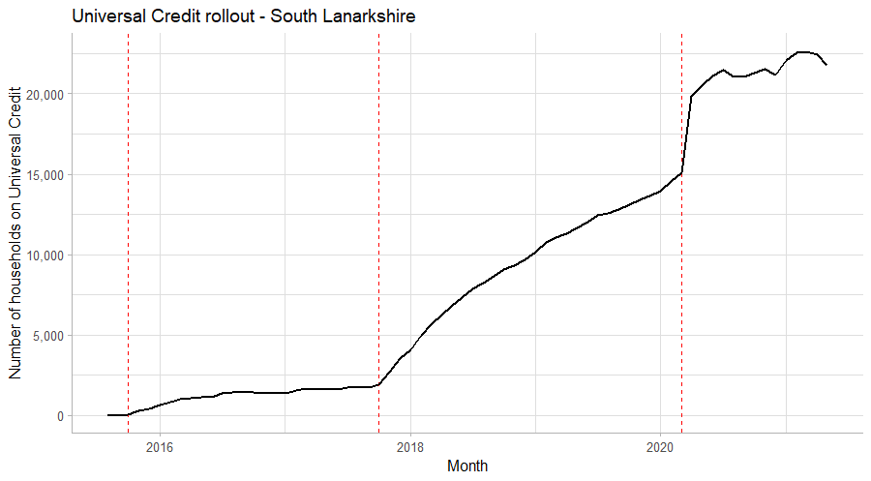
A taxonomy of rollout patterns
Across all Local authority areas there appears to be three ‘phases’ of exposure:
Some claimants; slow growth
Faster, linear growth in number of claimants
Covid ‘hump and plateau’ at start of lockdown March 2020
What events might define these periods, and do they mark clear exposure periods?
1
2
3

Slide 3
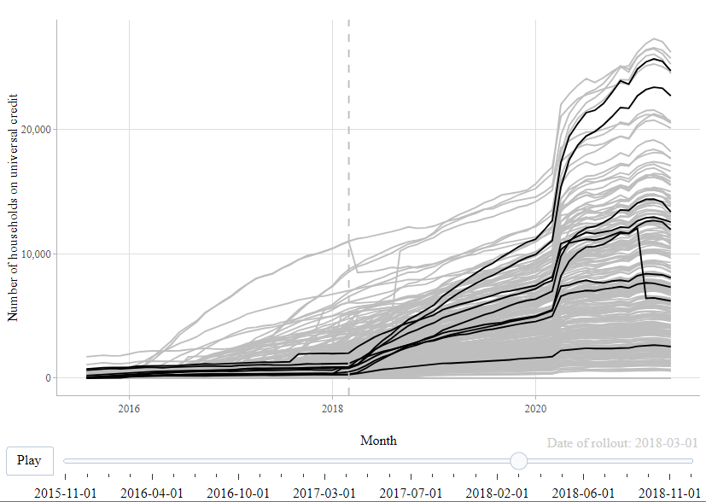
Graphing by Job Centre Plus and Gov planned date
Combining dates of planned rollout (slide #1) and data of households claiming UC from StatXplore, it appears that the scheduled launch date corresponds tightly with transition from phase 1 to phase 2 across ~730 Job Centres over a period of ~70 months.
Interactive graph at https://uc-rollout-plotly.web.app/

Slide 4
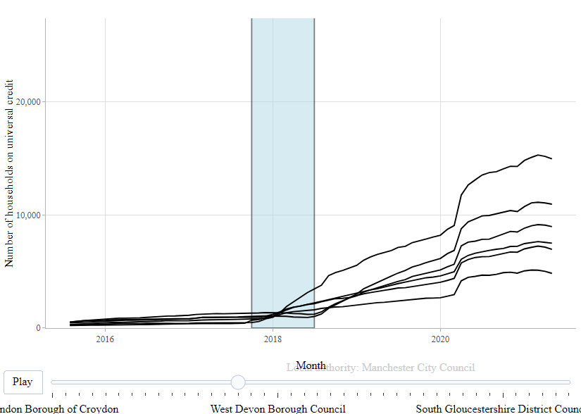
Graphing longer periods of transition within local authorities
In 40 LAs the difference in date of first rollout to last rollout was ≥1 month (with 4 LA rollouts spanning a year or more). This range of rollouts presents challenges in pinpointing the precise date of exposure of a person in one of these LAs to natural migration to full UC.
Interactive graph at https://uc-rollout-plotly.web.app/by_la_1pm/

Slide 5
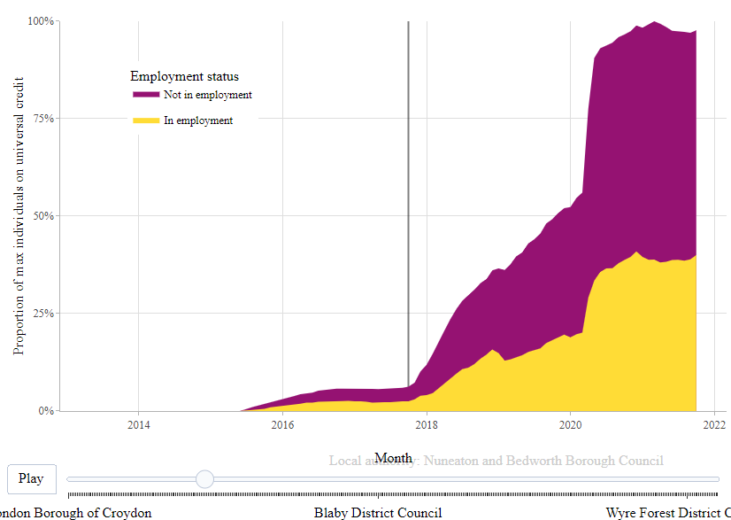
Splitting by claimant type
If different claimant types saw different likelihoods of exposure at points then this might aid adjustment of UC likelihood. As an example, perhaps employment status changes this? But initial graphs suggest not.
Interactive graph at https://uc-rollout-plotly.web.app/by_la_emp/

Slide 6
Implications and further questions
The rollout dates appear to be valid markers of a transition point from low rates of UC rollouts to linearly increasing exposure: https://www.gov.uk/government/publications/universal-credit-transition-to-full-service/universal-credit-transition-rollout-schedule-march-2018-to-december-2018
Does this transition mark a usable/sensitive differentiation of exposed and (relatively) unexposed?
Periods immediately before or after may experience anticipatory/delayed effects – sensitivity analyses could omit buffer periods.

